Slide 1
Equivalence Relations(7.5)
IT-209: Discrete Mathematics

Slide 2
Definition of Equivalence Relations
A relation R on a set A is an equivalence relation iff R is
  Reflexive
  Symmetric
  Transitive
Two elements related by an equivalence relation are called equivalent.
The notation a ~ b is often used to denote that a and b are equivalent elements w. r. t. a particular equivalence relation.
Example: Consider relation R = { (a,b) | len(a) = len(b) }, where len(a) means the length of string a
  It is reflexive: len(a) = len(a)
  It is symmetric: if len(a) = len(b), then len(b) = len(a)
  It is transitive: if len(a) = len(b) and len(b) = len(c), then len(a) = len(c)
  Thus, R is a equivalence relation

Slide 3
Equivalence relation example
Consider the relation R = { (a,b) | a ≡ b (mod m) }
  Remember that this means that m | a - b
  Called “congruence modulo m”
Is it reflexive: (a, a) ∈ R means that m | a - a
  a - a = 0, which is divisible by m
Is it symmetric: if (a,b) ∈ R then (b,a) ∈ R
  (a,b) means that m | a - b
  Or that km = a - b. Negating that, we get b - a = -km
  Thus, m | b - a, so (b,a) ∈ R
Is it transitive: if (a,b) ∈ R and (b,c) ∈ R then (a,c) ∈ R
  (a,b) means that m | a-b, or that km = a - b
  (b,c) means that m | b-c, or that lm = b - c
  (a,c) means that m | a-c, or that nm = a - c
  Adding these two, we get km+lm = (a - b) + (b - c)
  Or (k+l)m = a-c
  Thus, m divides a - c, where n = k+l
Thus, congruence modulo m is an equivalence relation

Slide 4
Equivalence Class
Let R be an equivalence relation on A. If a∈A, we define the set [a]={b∈A : bRa}, called the equivalence class containing a.
That is [a] is the set of all elements of A that are related to a.
We also define the set [A]_{R}={[a] : a∈A}, the set of all equivalence classes of A under equivalence relation R.
The element in the bracket is called a representative of the equivalence class. We could have chosen any one.
The number of equivalence classes is called the rank of the equivalence relation.

Slide 5
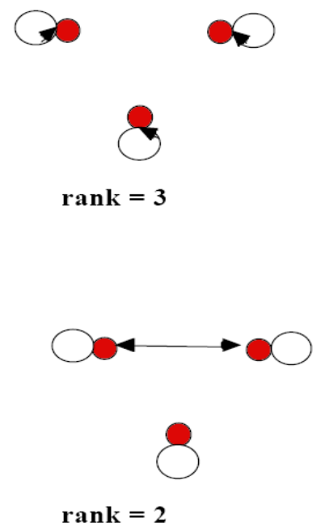
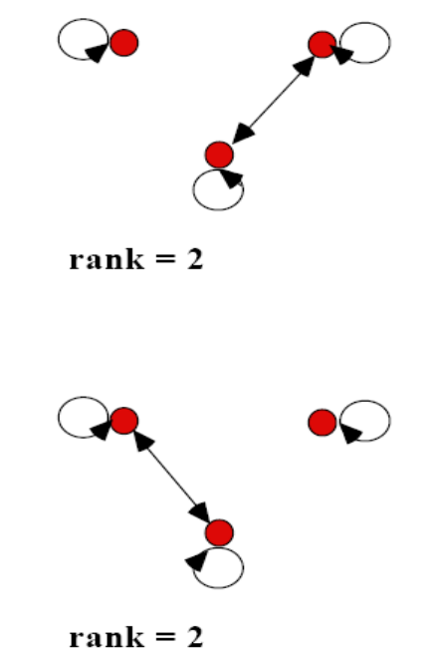
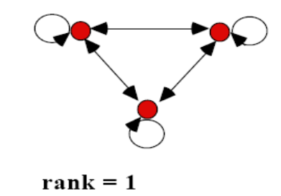
More on Equivalence Relations
It is easy to recognize equivalence relations using digraphs.
The equivalence class of a particular element forms a universal relation (contains all possible edges) between the elements in the equivalence class.
Example: All possible equivalence relations on a set A with 3 elements:

Slide 6
Theorem on Equivalence Relation
Theorem: Let R be an equivalence relation on A. Then either i) a R b or ii) [a] = [b] or iii) [a] ∩[b] ≠ Ø
Proof: We first show that i) → ii). Assume that a R b. We will prove that [a] = [b] by showing [a] ⊆ [b] and [b] ⊆ [a].
  Suppose c ∈ [a]. Then a R c. Because R is symmetric, a R b implies that there is b R a.
  Furthermore, because R is transitive and b R a and a R c, it follows that b R c. Hence c ∈ [b]. Which prove that [a] ⊆ [b]. Similarly we can prove [b] ⊆ [a].
Second, we show ii) → iii). Assume that [a] = [b]. It follows that [a]∩[b] ≠ Ø because [a] is non-empty (a ∈ [a] because R is reflexive)
Next we will show that iii) → i).
  Suppose that [a]∩[b] ≠ Ø. Then there is an element c with c ∈ [a] and c ∈ [b]. In other words, a R c and b R c. By the symmetric property c R b. Then by transitivity, because a R c and c R b, then a R b.
Because i) → ii); ii) → iii) and iii) → i), these three statements are equivalent.

Slide 7
Example equivalence classes
Consider the relation R = { (a,b) | a mod 2 = b mod 2 } on the set of integers
  Thus, all the even numbers are related to each other
  As are the odd numbers
The even numbers form an equivalence class
  As do the odd numbers
The equivalence class for the even numbers is denoted by [2] (or [4], or [784], etc.)
  [2] = { …, -4, -2, 0, 2, 4, … }
  2 is a representative of its equivalence class
There are only 2 equivalence classes formed by this equivalence relation

Slide 8
Example on equivalence classes
Consider the relation
R = { (a,b) | a = b or a = -b }
  Thus, every number is related to additive inverse
The equivalence class for an integer a:
  [7] = { 7, -7 }
  [0] = { 0 }
  [a] = { a, -a }
There are an infinite number of equivalence classes formed by this equivalence relation

Slide 9
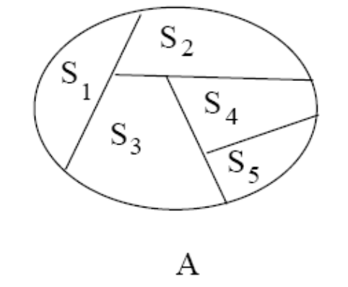
Partition of a Set
Definition: Let S₁, S₂, . . ., S_{n} be a collection of subsets of a set A. Then the collection forms a partition of A if the subsets are nonempty, disjoint and exhaust A:
  S_{i} ≠ Ø
  S_{i} ∩ S_{j} = Ø if i ≠ j
  U S_{i} = A
Note that { {}, {1,3}, {2} } is not a partition (it contains the empty set).
{ {1,2}, {2, 3} } is not a partition because the subsets are not disjoint.
{ {1}, {2} } is not a partition of {1, 2, 3} because none of its blocks contains 3.

Slide 10
Rosen, section 8.5, question 1
Which of these relations on {0, 1, 2, 3} are equivalence relations? Determine the properties of an equivalence relation that the others lack
{ (0,0), (1,1), (2,2), (3,3) }
  Has all the properties, thus, is an equivalence relation
{ (0,0), (0,2), (2,0), (2,2), (2,3), (3,2), (3,3) }
  Not reflexive: (1,1) is missing
  Not transitive: (0,2) and (2,3) are in the relation, but not (0,3)
{ (0,0), (1,1), (1,2), (2,1), (2,2), (3,3) }
  Has all the properties, thus, is an equivalence relation
{ (0,0), (1,1), (1,3), (2,2), (2,3), (3,1), (3,2) (3,3) }
  Not transitive: (1,3) and (3,2) are in the relation, but not (1,2)
{ (0,0), (0,1) (0,2), (1,0), (1,1), (1,2), (2,0), (2,2), (3,3) }
  Not symmetric: (1,2) is present, but not (2,1)
  Not transitive: (2,0) and (0,1) are in the relation, but not (2,1)

Slide 11
Rosen, Section 8.5, question 9
Suppose that A is a non-empty set, and f is a function that has A as its domain. Let R be the relation on A consisting of all ordered pairs (x,y) where f(x) = f(y)
  Meaning that x and y are related if and only if f(x) = f(y)
Show that R is an equivalence relation on A
Reflexivity: f(x) = f(x)
  True, as given the same input, a function always produces the same output
Symmetry: if f(x) = f(y) then f(y) = f(x)
  True, by the definition of equality
Transitivity: if f(x) = f(y) and f(y) = f(z) then f(x) = f(z)
  True, by the definition of equality

Slide 12
Rosen, section 8.5, question 44
Which of the following are partitions of the set of integers?
The set of even integers and the set of odd integers
  Yes, it’s a valid partition
The set of positive integers and the set of negative integers
  No: 0 is in neither set
The set of integers divisible by 3, the set of integers leaving a remainder of 1 when divided by 3, and the set of integers leaving a remaineder of 2 when divided by 3
  Yes, it’s a valid partition
The set of integers less than -100, the set of integers with absolute value not exceeding 100, and the set of integers greater than 100
  Yes, it’s a valid partition
The set of integers not divisible by 3, the set of even integers, and the set of integers that leave a remainder of 3 when divided by 6
  The first two sets are not disjoint (2 is in both), so it’s not a valid partition

Slide 13
Thank You
Study all the solved problem from your text book.
Try to solve related problems from exercise.
Text from Rosen 8.5

